Slide 1


Slide 2
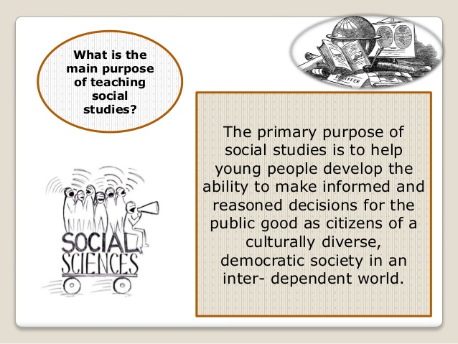

Slide 3
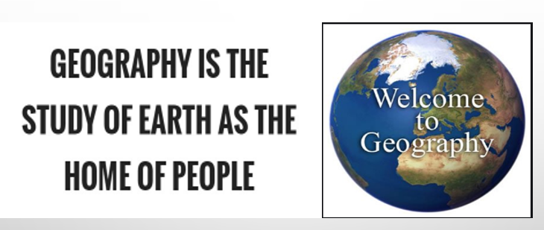

Slide 4
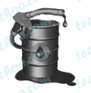
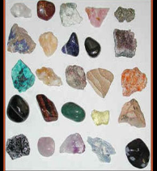
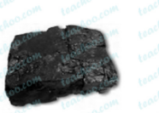
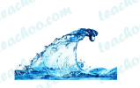



Today we are going to discuss about ?

Slide 5
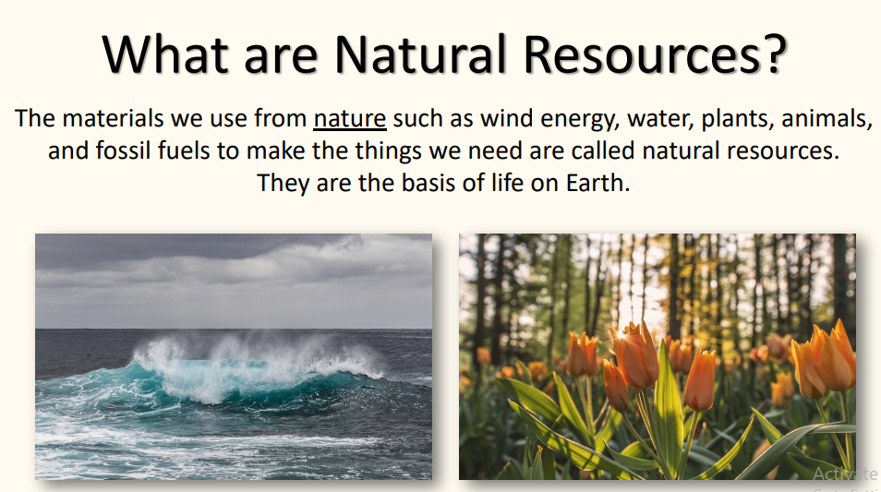
Yes, they are natural resources……

Slide 6
What is meant by resources? *Resource is a collective wealth of a country . *our environment provides us with numerous things which met our requirements. These things known as resources.

Slide 7
Exactly if you want to know that…. Resource is something which human society attaches value due to its usefulness…

Slide 8
This means that, what is considered a resource can change over time.. For example, lets talk about oil…until the late 19th century it was not considered as a valuable resource.. Why?

Slide 9
Yes ..we are going discuss about geography.. 1.Natural resources

Slide 10
In this chapter we will discuss about 1.Value of resource 2.Types of resource 3.How human activities affect these resources…

Slide 11
Value of resources is determined by its quantity and quality and its usefulness in the present times..

Slide 12
Three Characteristics of resources:- 1.Utility(usefulness) 2.Limited availability 3.Potential(possibilities to develop)

Slide 13
Factors which determine the value of a resource lets discuss

Slide 14
1.People from different cultural backgrounds attach different values to different resources. Eg:Green tea in Japan

Slide 15
The value of certain resource depends the economy of a country.. How? Ex:coal and iron ore(rock which contains iron minerals) hint:- [developed countries,undeveloped countries]

Slide 16

Value of the resource depends upon its demand.. Example:cotton,timber,food grains

Slide 17

Value of resources depends on its aesthetic(beauty) quality. Example:handicraft,handloom, jute

Slide 18
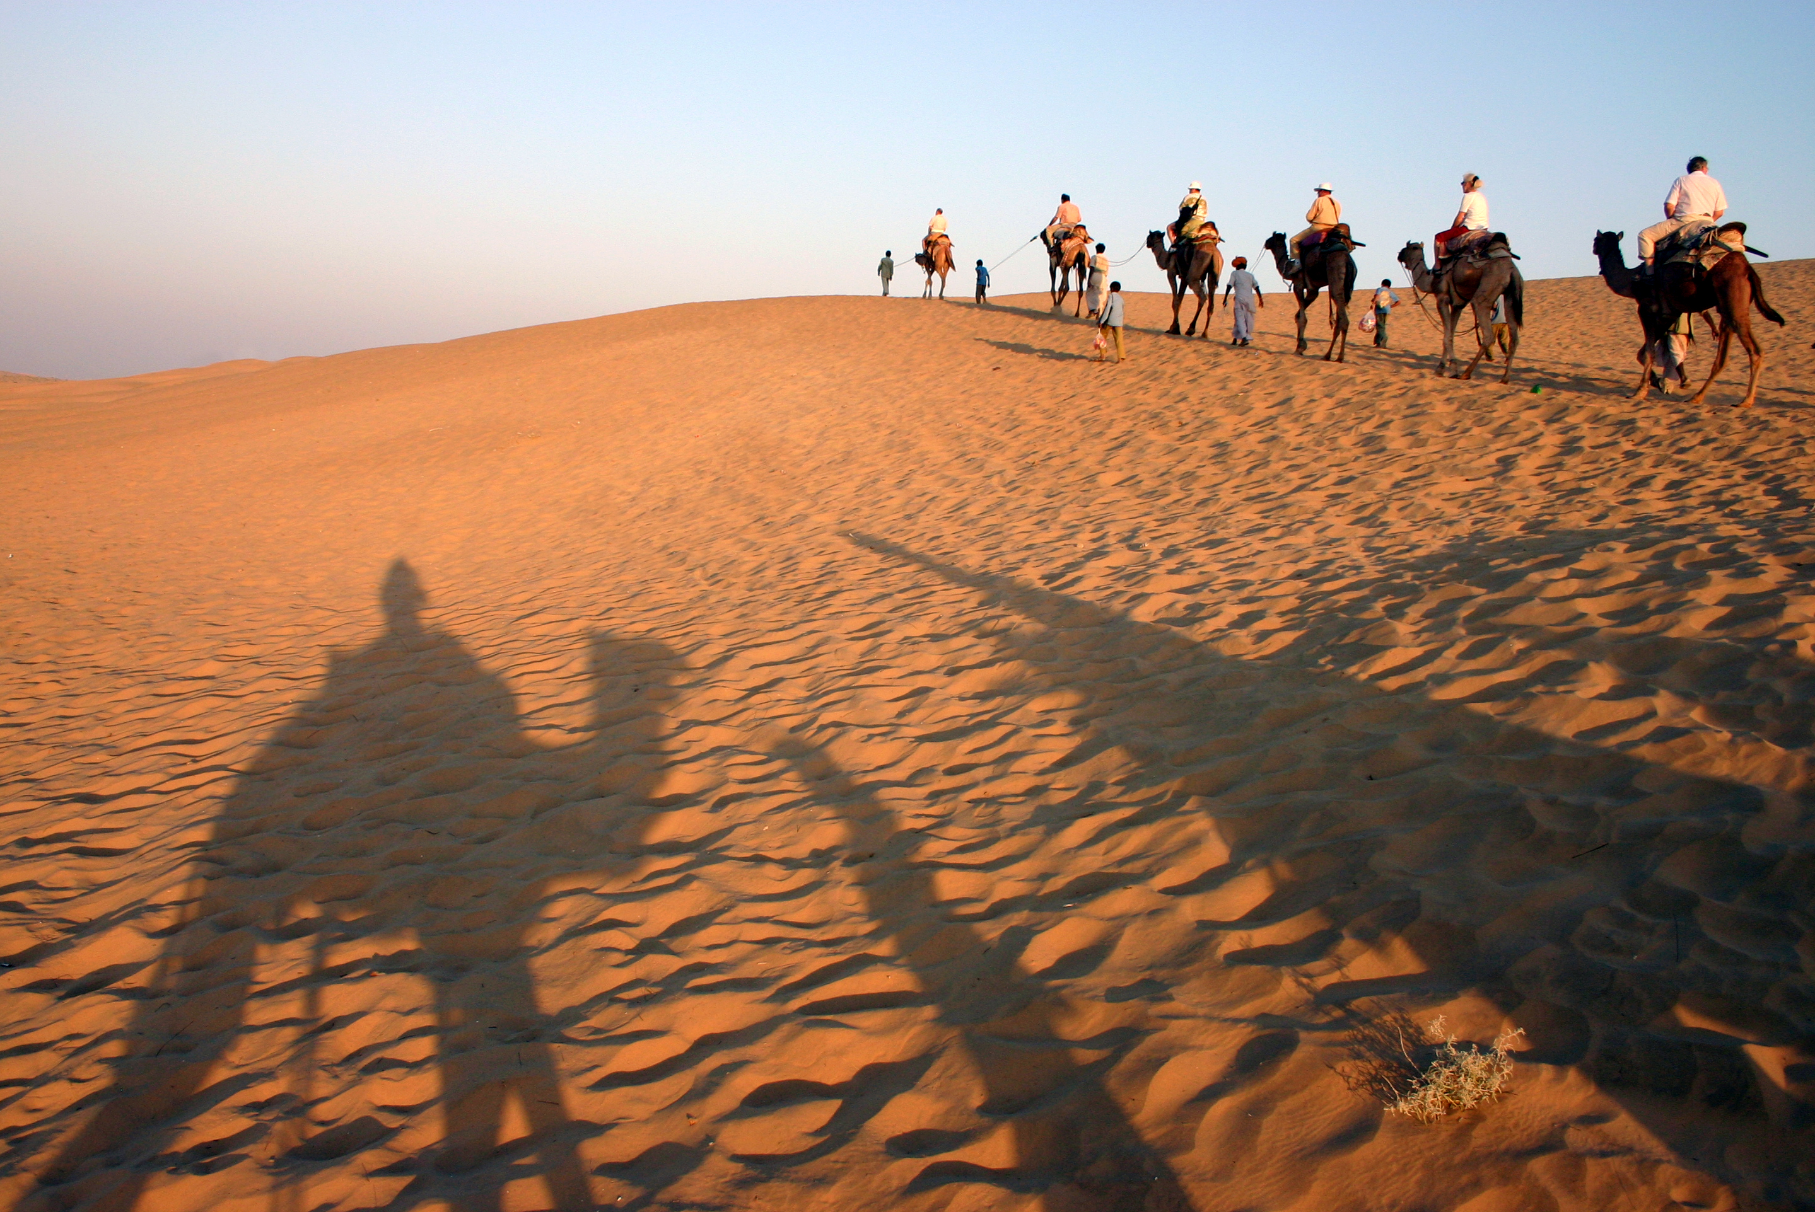
Value of resources depends on its availability example: water in desert area

Slide 19
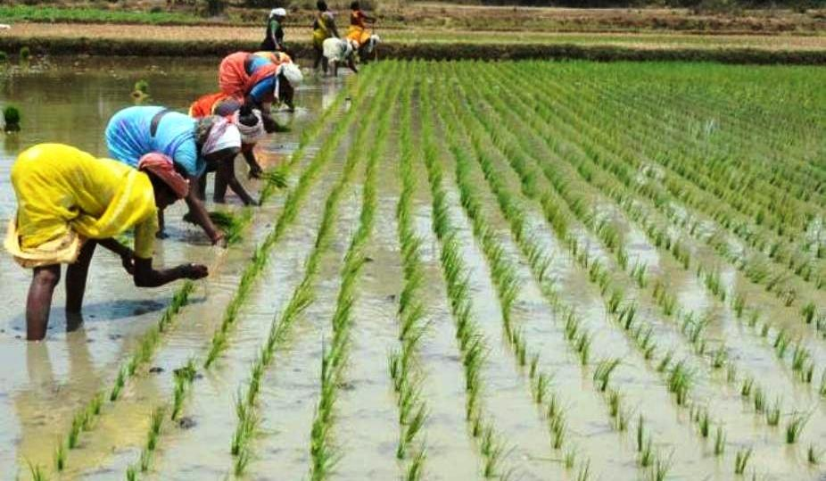
Economic value of a resource may change with time. Example:agricultural land

Slide 20
People are valued because of their knowledge and ideas which lead to great inventions and discoveries

Slide 21
Modern technology help to convert materials into resources. Example :large reserves of mineral oil under the sea floors are no value unless we extract the oil and make it usable.With modern technology it can be safely drilled, refined and used

Slide 22
Types of resources *Natural resources *Human resources *Human - made resources

Slide 23
Natural resources *Naturally occurring materials which are used by humans in their natural form or with little modification are known as natural resources. Example:Minerals,Soil,Water,Plants and animals

Slide 24
Materials like coal and iron ore were considered useful resources only after humans learnt how to utilize these materials for their benefit.

Slide 25
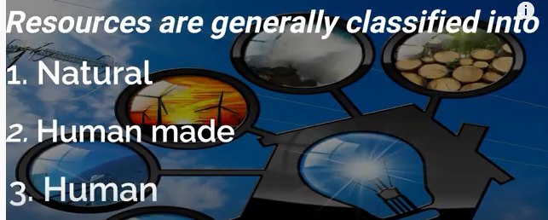

Slide 26

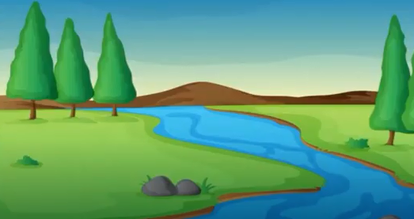
NATURAL RESOURCES

Slide 27
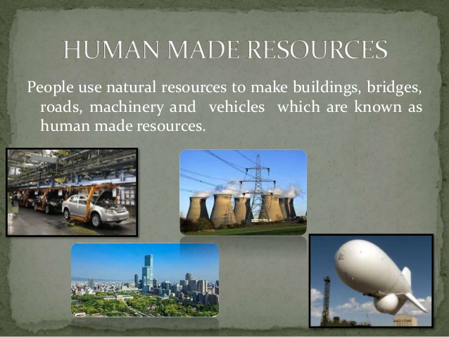
HUMAN MADE RESOURCES

Slide 28


Slide 29



Slide 30

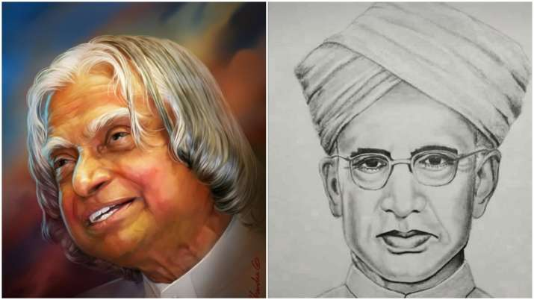

Slide 31
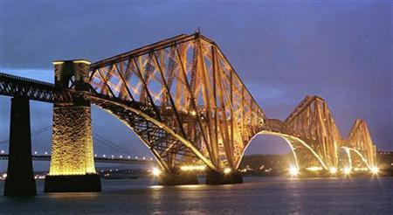

Which is more valuable resource?

Slide 32
Human resources are considered as more valuable than others because…

Slide 33
They give their valuable services and knowledge to the society

Slide 34
Value of resources is determined by its quantity and quality and its usefulness in the present times..

Slide 35
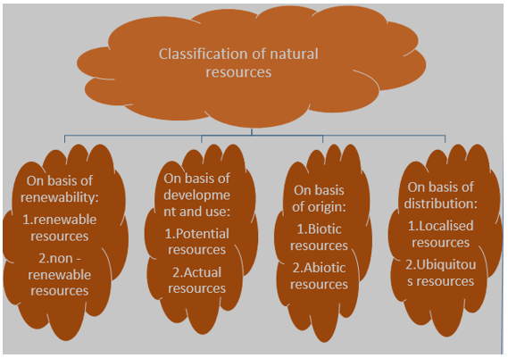

Slide 36
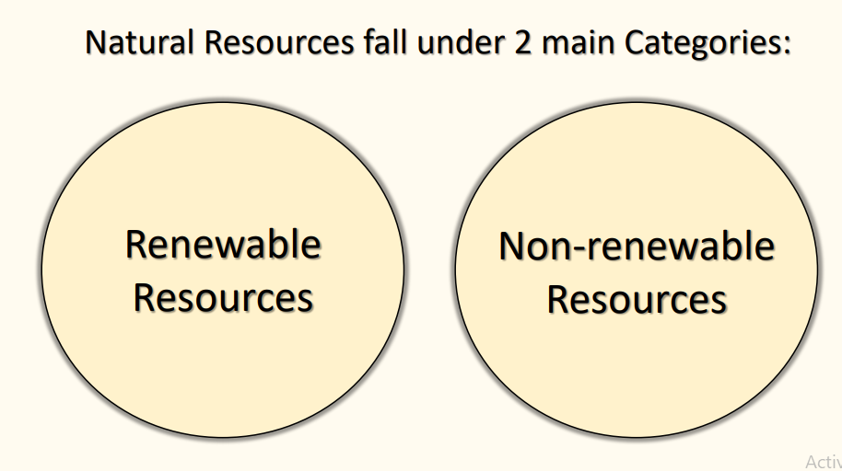

Slide 37
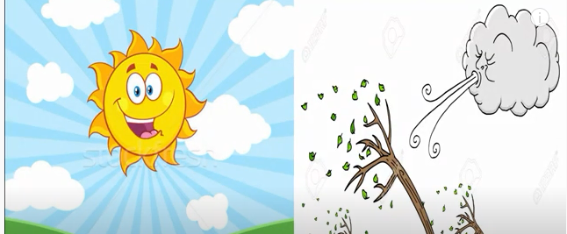
RENEWABLE RESOURCES

Slide 38
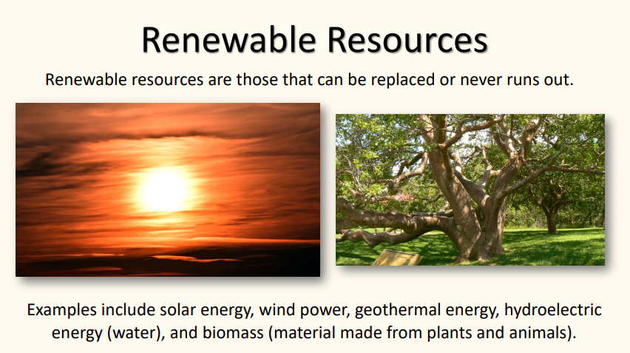

Slide 39
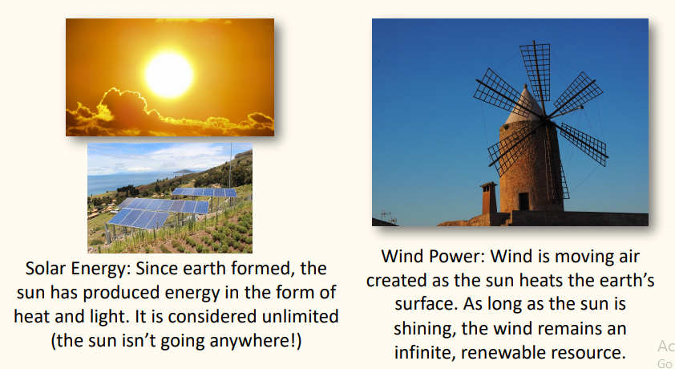

Slide 40
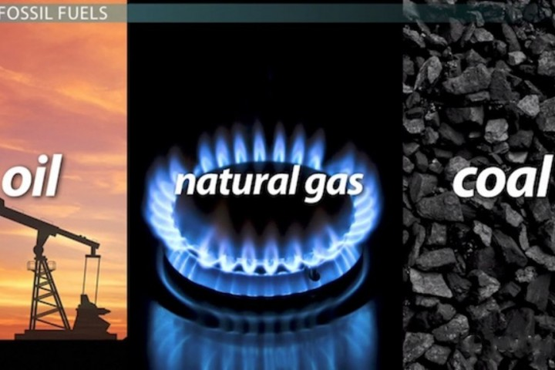
NON - RENEWABLE RESOURCES

Slide 41
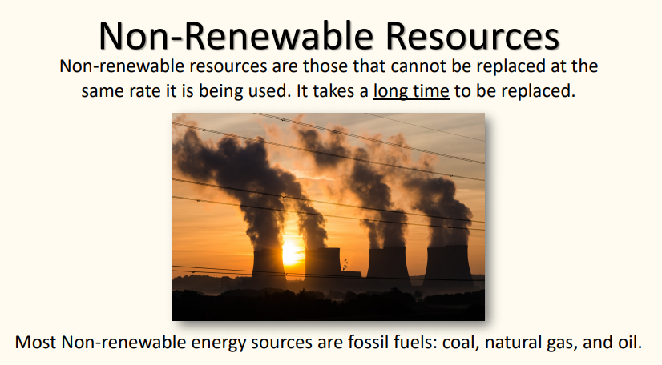

Slide 42
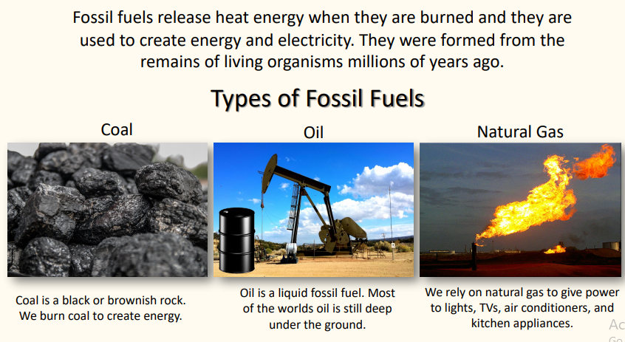

Slide 43
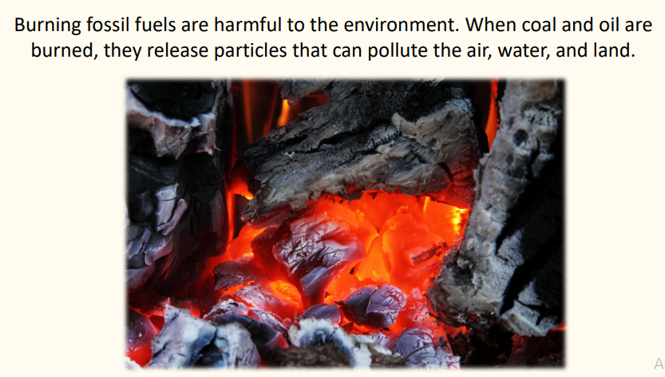

Slide 44
Kyoto Protocol is a protocol of the United Nations Frame work conventions on climate change aimed at fighting global warming…

Slide 45
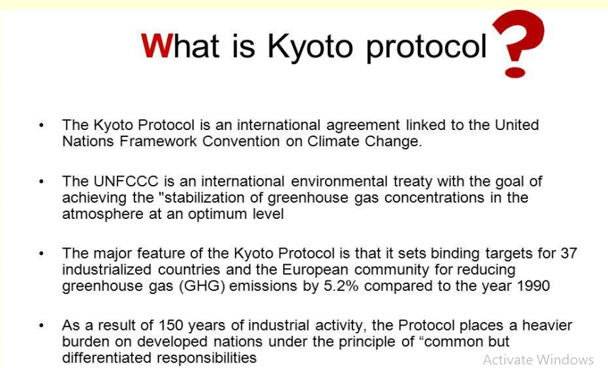
UNFCCC: The United Nations Framework Convention on Climate Change

Slide 46
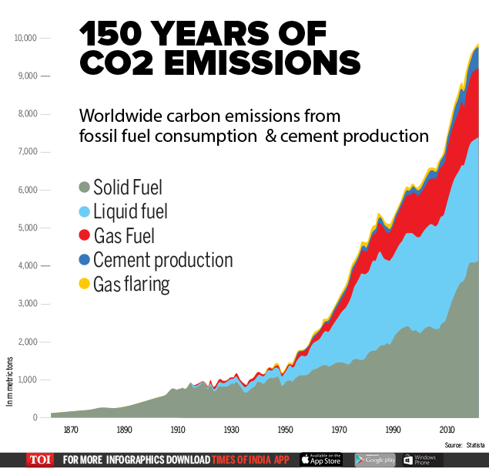

Slide 47
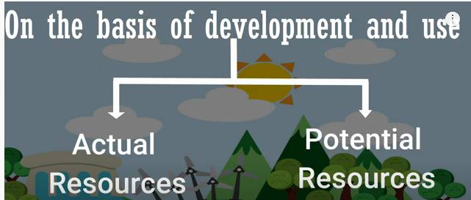

Slide 48
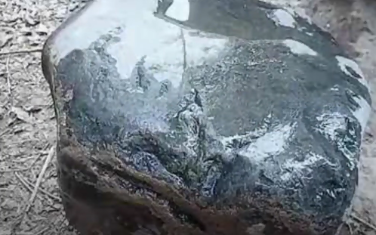
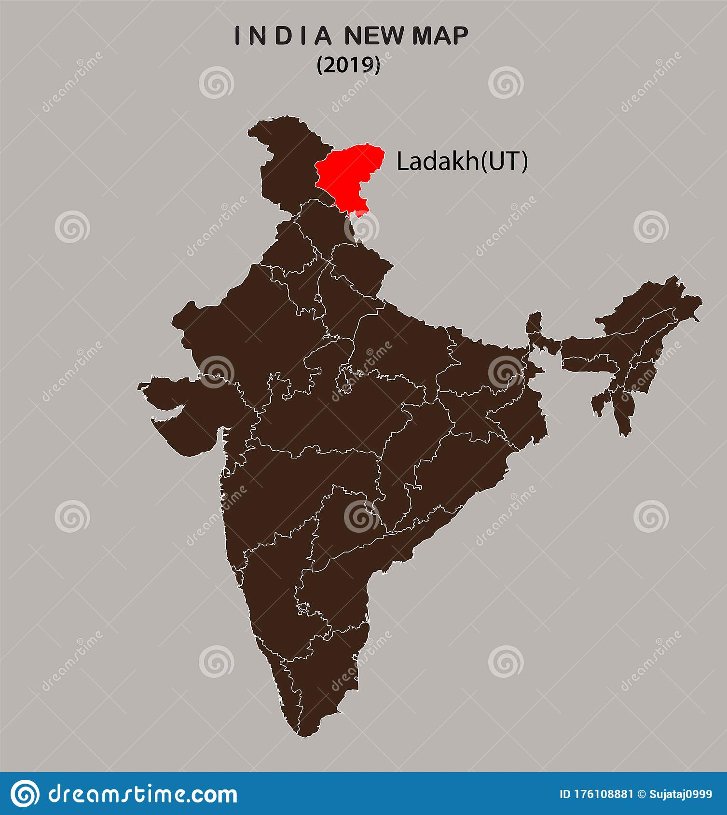
Uranium in Ladakh – Potential resources

Slide 49
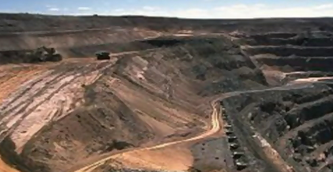
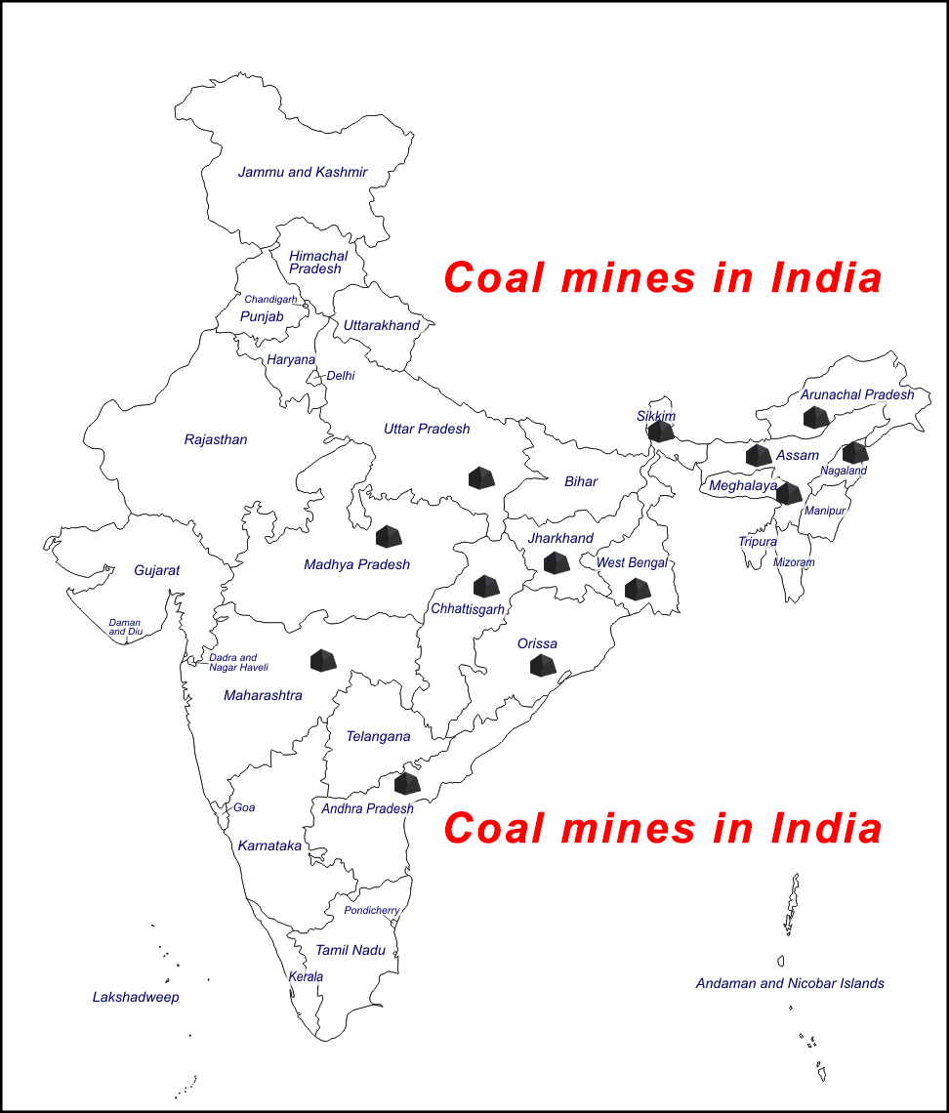
Coal mines in India - Actual resources

Slide 50
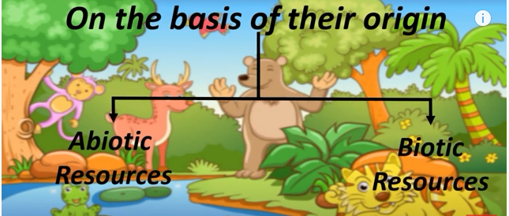

Slide 51
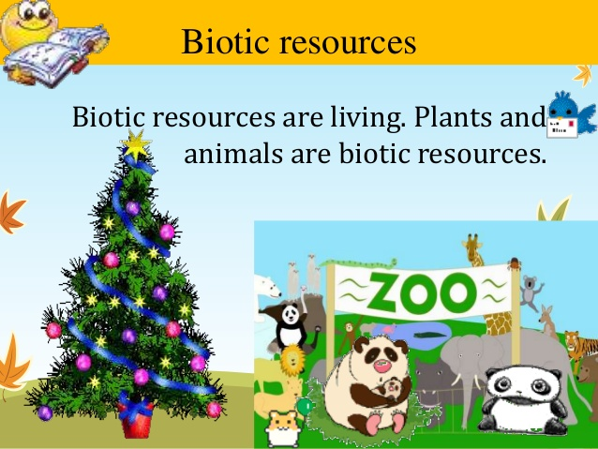
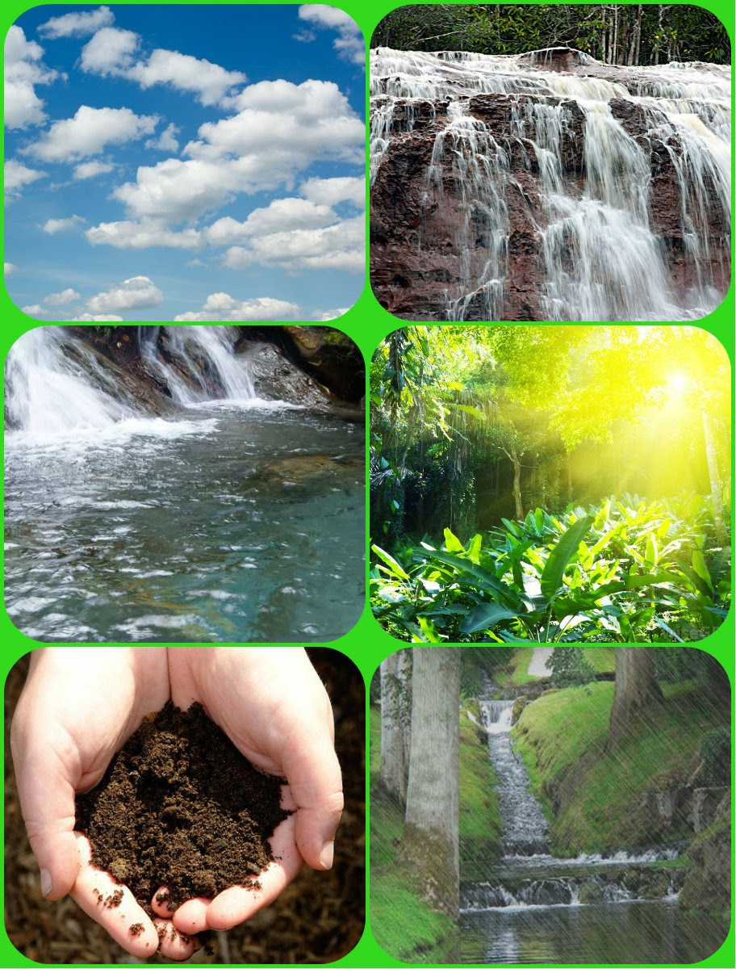
Abiotic resources

Slide 52
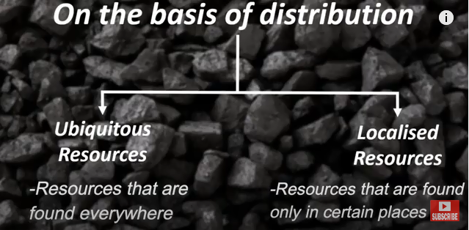

Slide 53
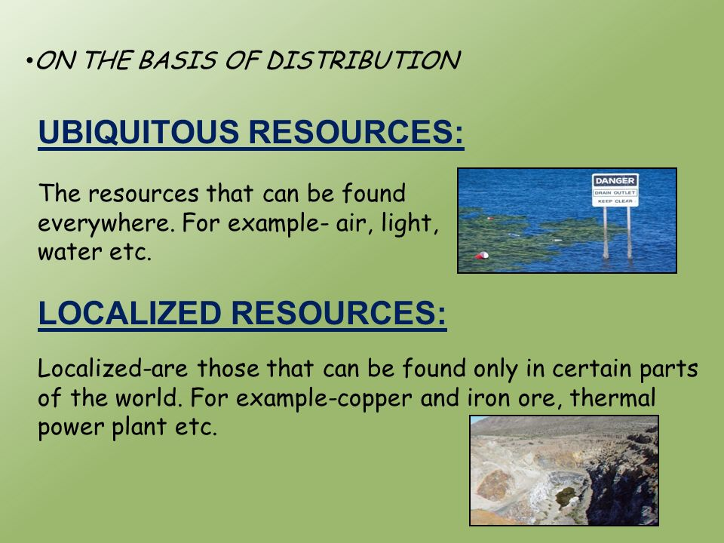

Slide 54
HW - Collect the Natural resources of Tamil Nadu, then classify the those resources

Slide 55
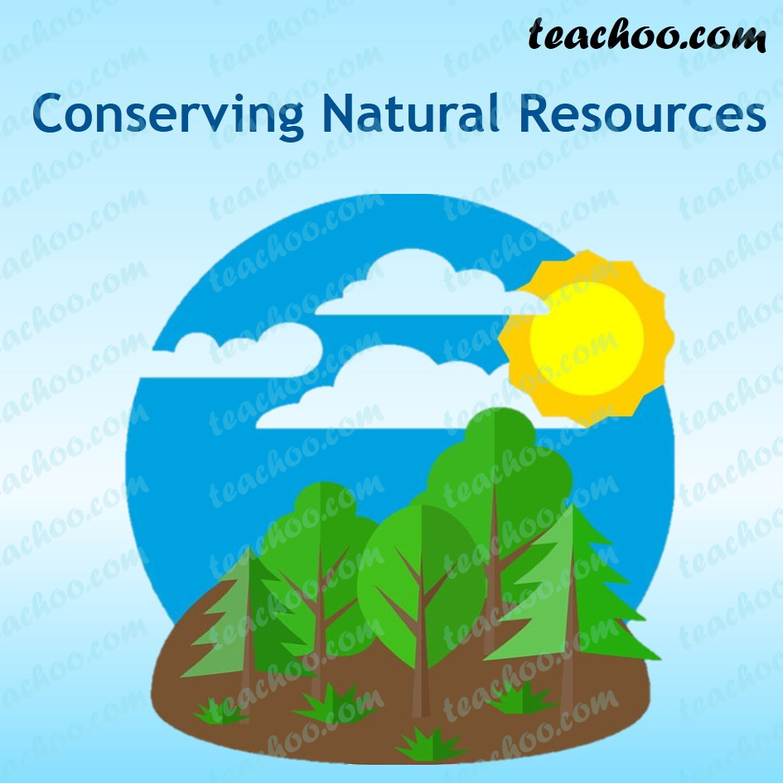
Activity –Conduct awareness play on “conservation of resources “

Slide 56
THANK YOU!

